Slide 1
Lending club case study

Slide 2
Business objective
The objective of this analysis is to assist in decision-making when a loan application is received, determining whether to approve or reject it based on specific factors.
Dataset Information:
The dataset includes historical data on loan applicants, capturing whether they defaulted or not. It contains details of approved loans but does not include information about rejected applications. Loan status is categorized into three types: Fully Paid, Current, and Charged-Off.
Data Cleaning and Preparation:
The initial step involves organizing and preparing the dataset to ensure it is ready for analysis. This process will include addressing missing values, correcting inconsistencies, and formatting the data as needed to derive meaningful insights.

Slide 3
Data Cleaning & Pre-processing
Loading Loan Data from CSV Import the dataset from a CSV file to initiate the analysis process.
Identifying Null Values Check for missing or null values within the dataset to ensure completeness.
Reviewing Unique Values Analyze the unique values in each column to better understand the data distribution.
Detecting Duplicates Identify and handle any duplicate records in the dataset to maintain data integrity.
Removing Unnecessary Records & Columns Drop irrelevant or redundant rows and columns that do not contribute to the analysis.
Essential Data Functions Apply key functions to explore and manipulate the dataset efficiently.
Converting Data Types Ensure the correct data types for each column to facilitate proper analysis and modeling.
Handling Outliers Identify and treat outliers to maintain the accuracy of data analysis.
Filling Missing Values Use imputation techniques to fill in missing values and ensure consistency across the dataset.

Slide 4
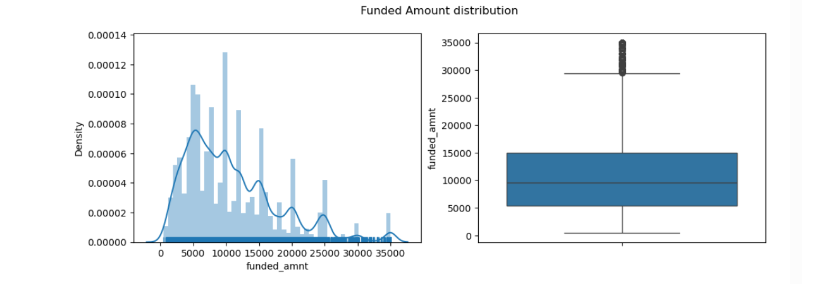
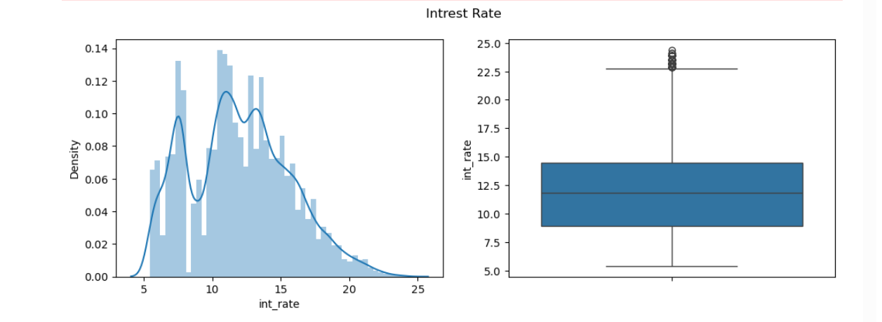
Funded amount and interest rate
Average Funded Amount: ₹10,880.79
Average Interest Rate: 11.98%
Key Insight: The typical loan issued to customers is approximately ₹10,880.79, with an average interest rate of 11.98%, reflecting a balanced approach in lending decisions based on risk and repayment terms.

Slide 5
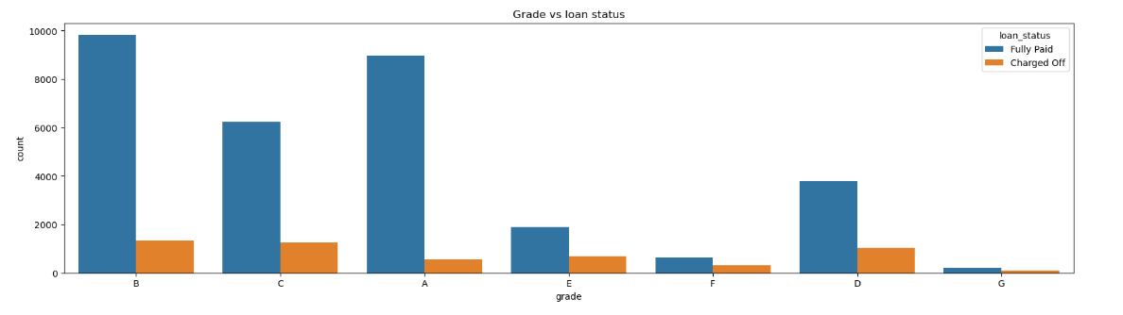
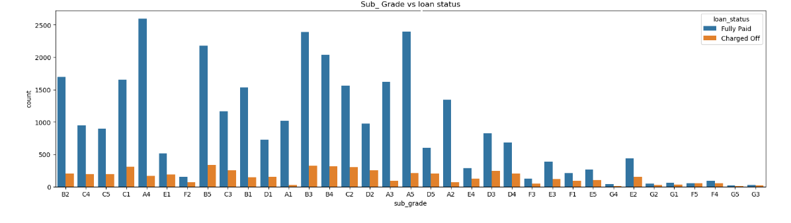
Grade and Sub-Grade
Grade: The majority of approved loans belong to higher grades, indicating they are low-risk and less likely to default. However, loans with a 60-month term tend to have a larger proportion of lower-grade loans, which are associated with higher risk.
Sub Grade: A deeper analysis of sub-grades reveals that within each grade, there is a noticeable skew towards lower sub-grades, suggesting that most loans in a given grade are closer to the lower end of the grading spectrum.

Slide 6
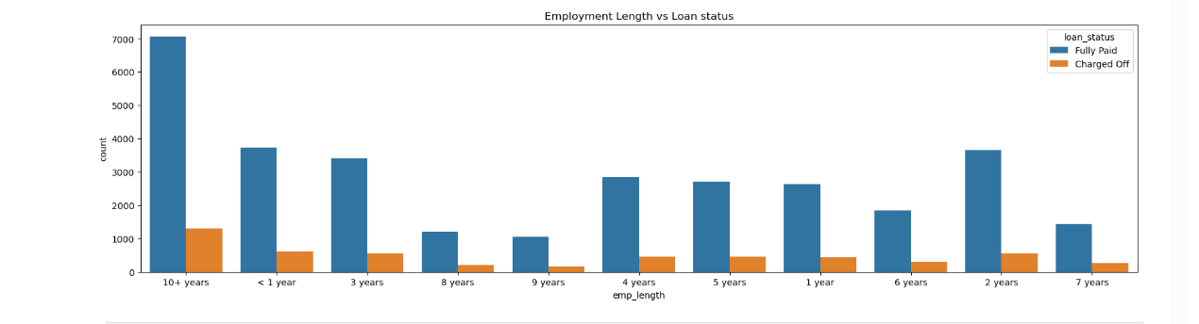
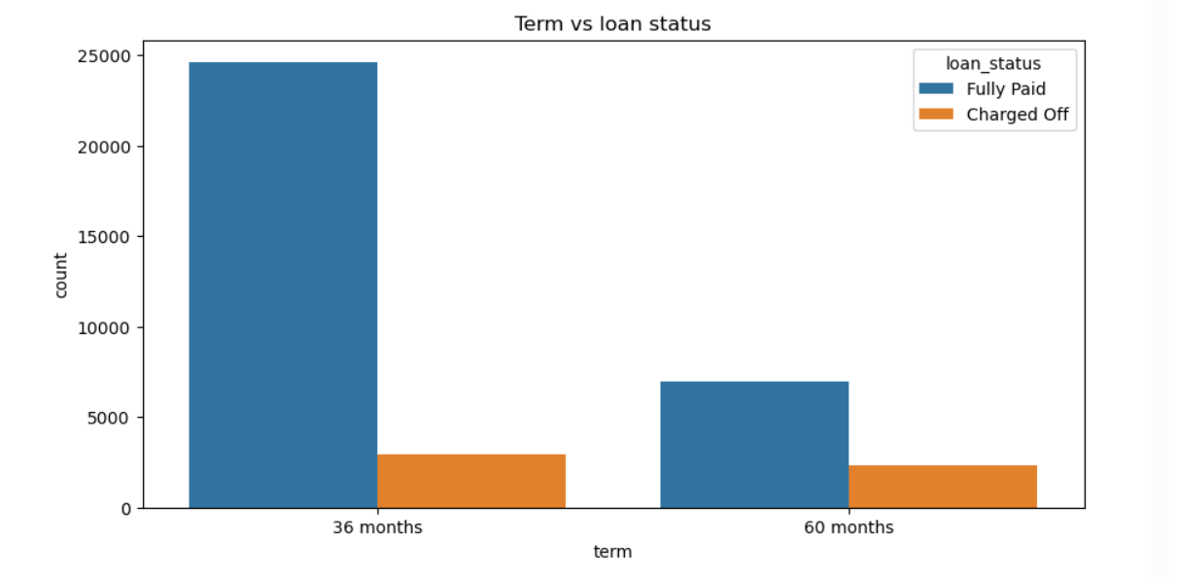
Purpose distribution and address state distribution
Grade:​ The majority of approved loans belong to higher grades, indicating they are low-risk and less likely to default. However, loans with a 60-month term tend to have a larger proportion of lower-grade loans, which are associated with higher risk.​ ​
Sub Grade:​ A deeper analysis of sub-grades reveals that within each grade, there is a noticeable skew towards lower sub-grades, suggesting that most loans in a given grade are closer to the lower end of the grading spectrum.​

Slide 7
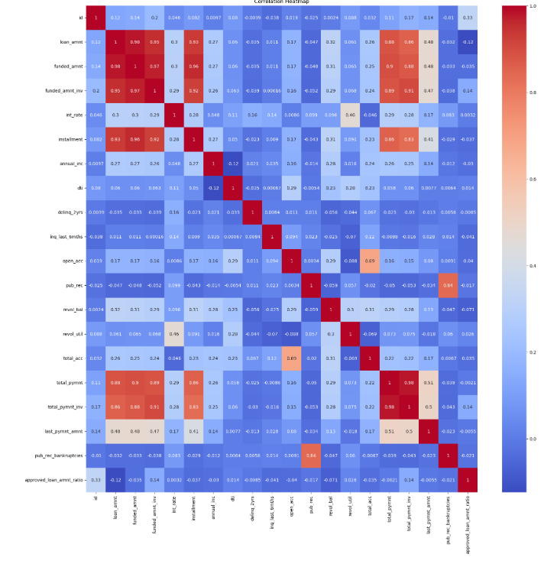
Heat Map
installment has a strong correlation with funded_amnt, loan_amnt, and funded_amnt_inv term has a strong correlation with interest rate annual_inc has a strong correlation with loan_amount Weak Correlation
dti has weak correlation with most of the fields emp_length has weak correlation with most of the fields Negative Correlation
pub_rec_bankrupticies has a negative correlation with almost every field annual_inc has a negative correlation with dti

Slide 8
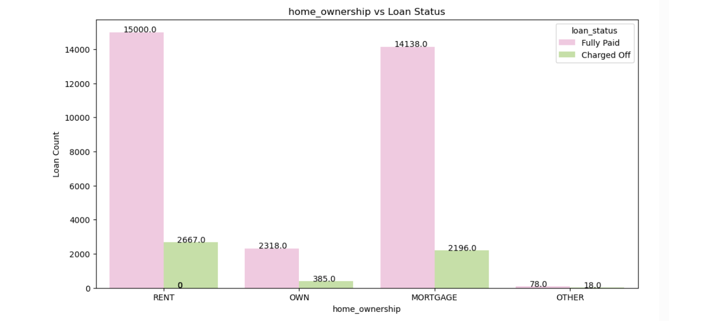
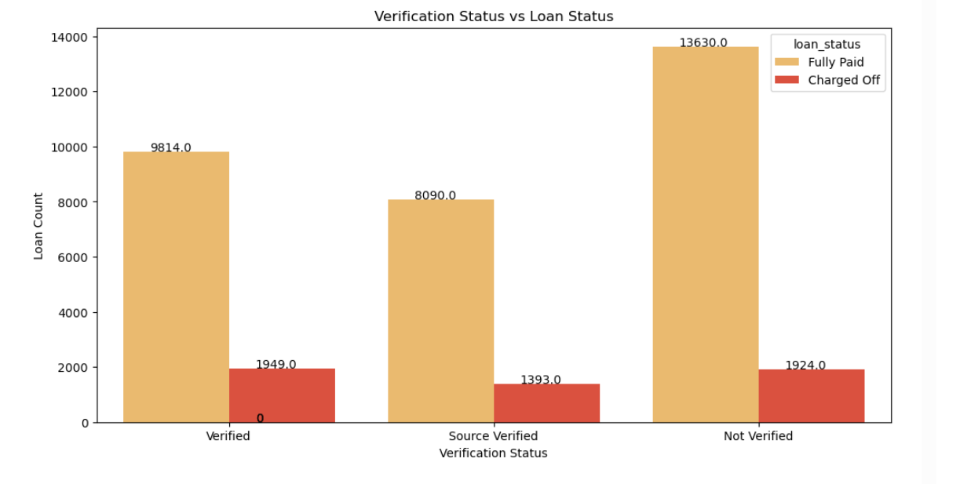
Home ownership and verification status VS loan status
The likelihood of default is higher among individuals in categories other than their own when it comes to homeownership. Additionally, the population distribution of individuals taking loans is skewed towards those with mortgages and renters.
The maximum number of defaulters comes from the Verified category, but the default ratio is higher in the Source Verified category, indicating that Source Verified is at a higher risk of default.

Slide 9
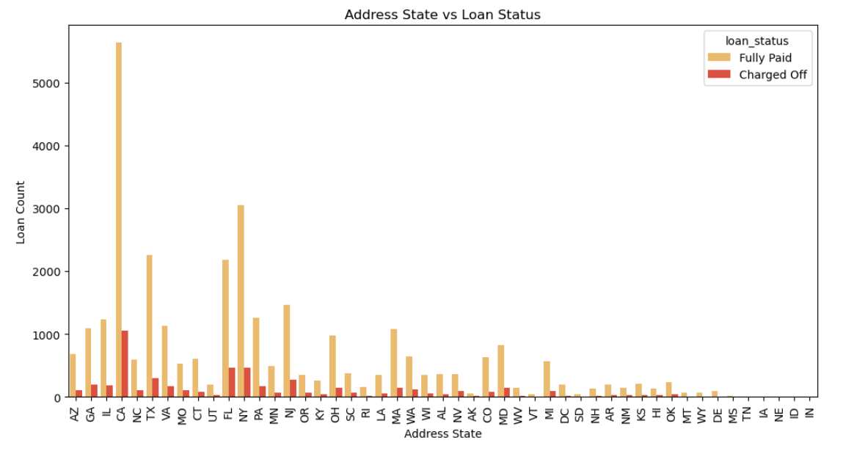
Location Based
Large metropolitan cities such as California, New York, Texas, and Florida have a higher volume of loans, including a significant number of defaults. However, the likelihood of defaulting is lower in these areas.

Slide 10
Key Insights on Loan Defaults: Correlations, Trends, and Risk Factors
Risk Factors for Default: Loan applicants with lower credit grades (B, C, D), longer loan terms (60 months), and lower annual incomes (<$40,000) are more likely to default. Verified applicants also show a higher risk of default.
Loan Characteristics: Higher loan amounts and interest rates are associated with higher default rates, particularly for loans above $15,000 and interest rates between 13-17%.
Employment and Housing: Long-term employment (>10 years) and rented or mortgaged housing correlate with higher default rates, suggesting that stable employment does not guarantee loan repayment success.
State and Loan Type Trends: Applicants from California, Florida, and New York have a higher likelihood of default. Loans for small businesses and education tend to have lower funded amounts compared to requested amounts.
Economic Trends and Loan Distribution: Loan amounts and terms have become more varied over the years, with noticeable outliers in 2008 and 2011. December sees higher loan amounts taken, and higher tenure loans come with higher interest rates.

Slide 11
Major Driving factor which can be used to predict the chance of defaulting and avoiding Credit Loss:
1. DTI
2. Grades
3. Verification Status
4. Annual income
5. Pub_rec_bankruptcies

Slide 12
THANK YOU

